Slide 1


FRAUD DETECTION ANALYSIS
FRAUD DETECTION ANALYSIS

Slide 2
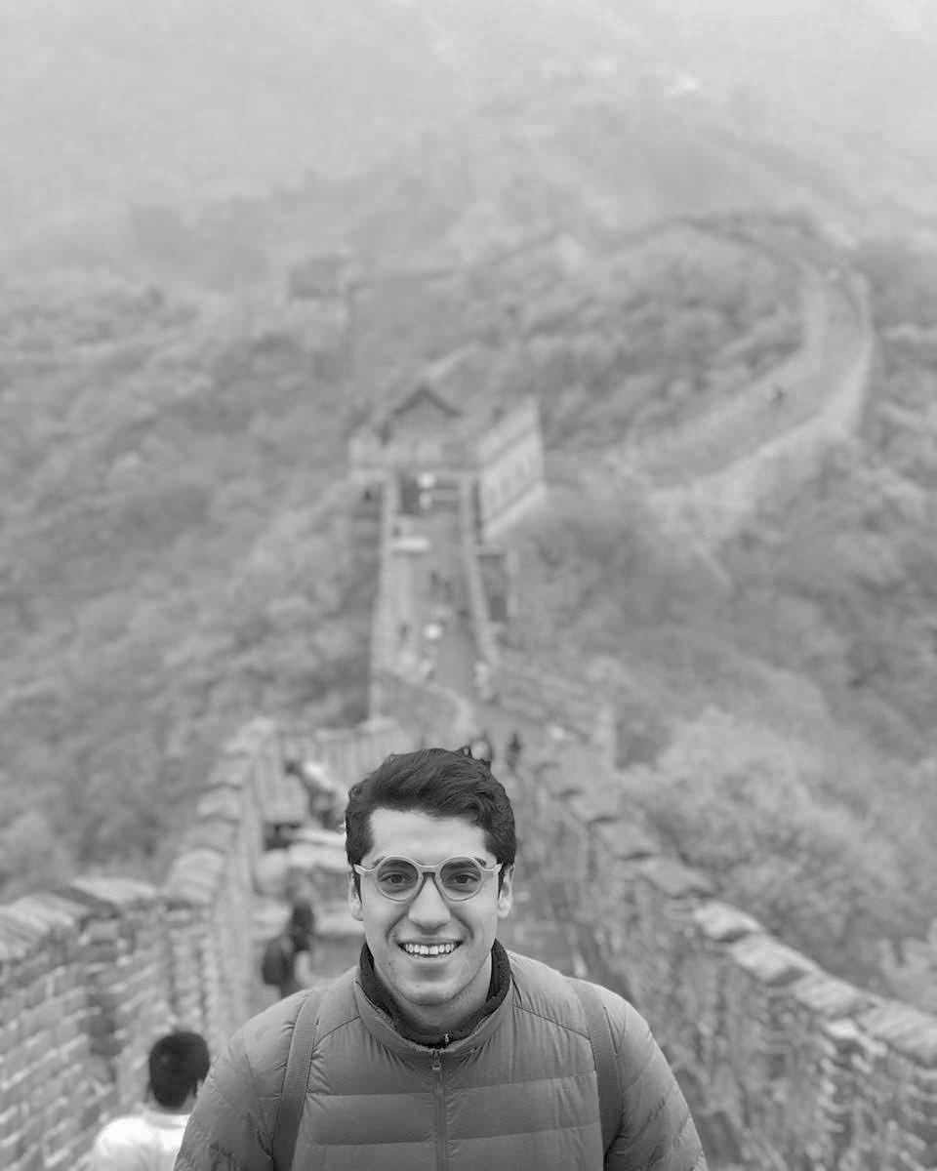
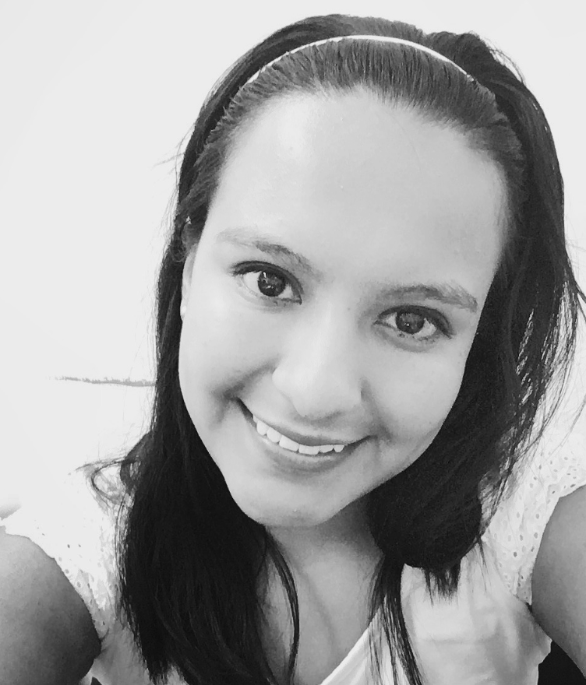

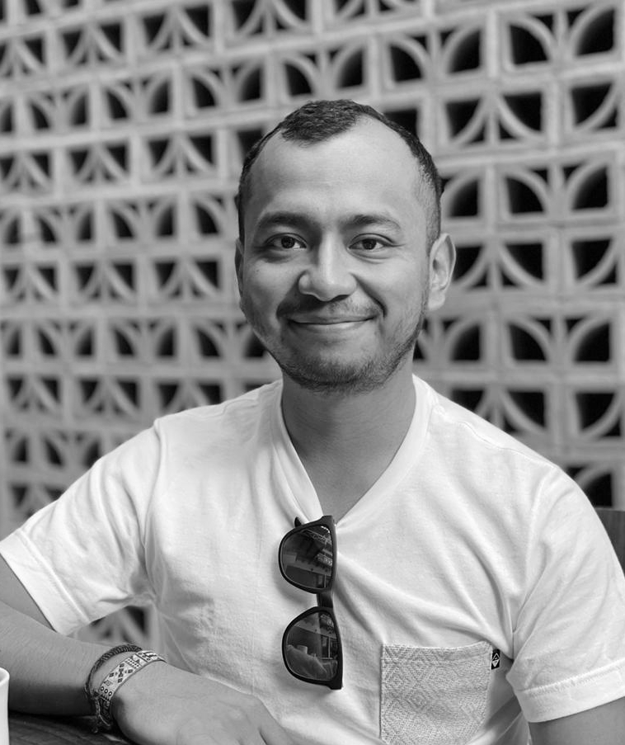
MEET THE TEAM
MEET THE TEAM
Diego Pérez Ortega
https://github.com/diegoperezo97
Alejandra Cano
https://github.com/AleCano1
Rodrigo Salas
https://github.com/RodrigoSalAlv
Andrei López
https://github.com/andreimlg

Slide 3



SELECTED TOPIC
SELECTED TOPIC
E-COMMERCE FRAUD ANALYSIS
Mercado Pago is the largest online payment platform in Mexico.
Despite being the largest e-commerce platform in Latin America nowadays, Mercado Pago still does not have a tool that helps its vendors deal with scammers.
Scammers
Chargebacks
Claims
Phising

Slide 4

QUESTIONS TO ANSWER
QUESTIONS TO ANSWER
WHAT, WHERE, HOW, WHEN
Is it a safe operation?
What variables are related to the fraudulent buyer?
What are the big patterns the purchase shows?
What range of charges is most likely to be fraudulent?
What is the fraudulent buyer likely to buy?
Are fraud operations made from a specific region?

Slide 5












TECHNOLOGIES
TECHNOLOGIES

Slide 6
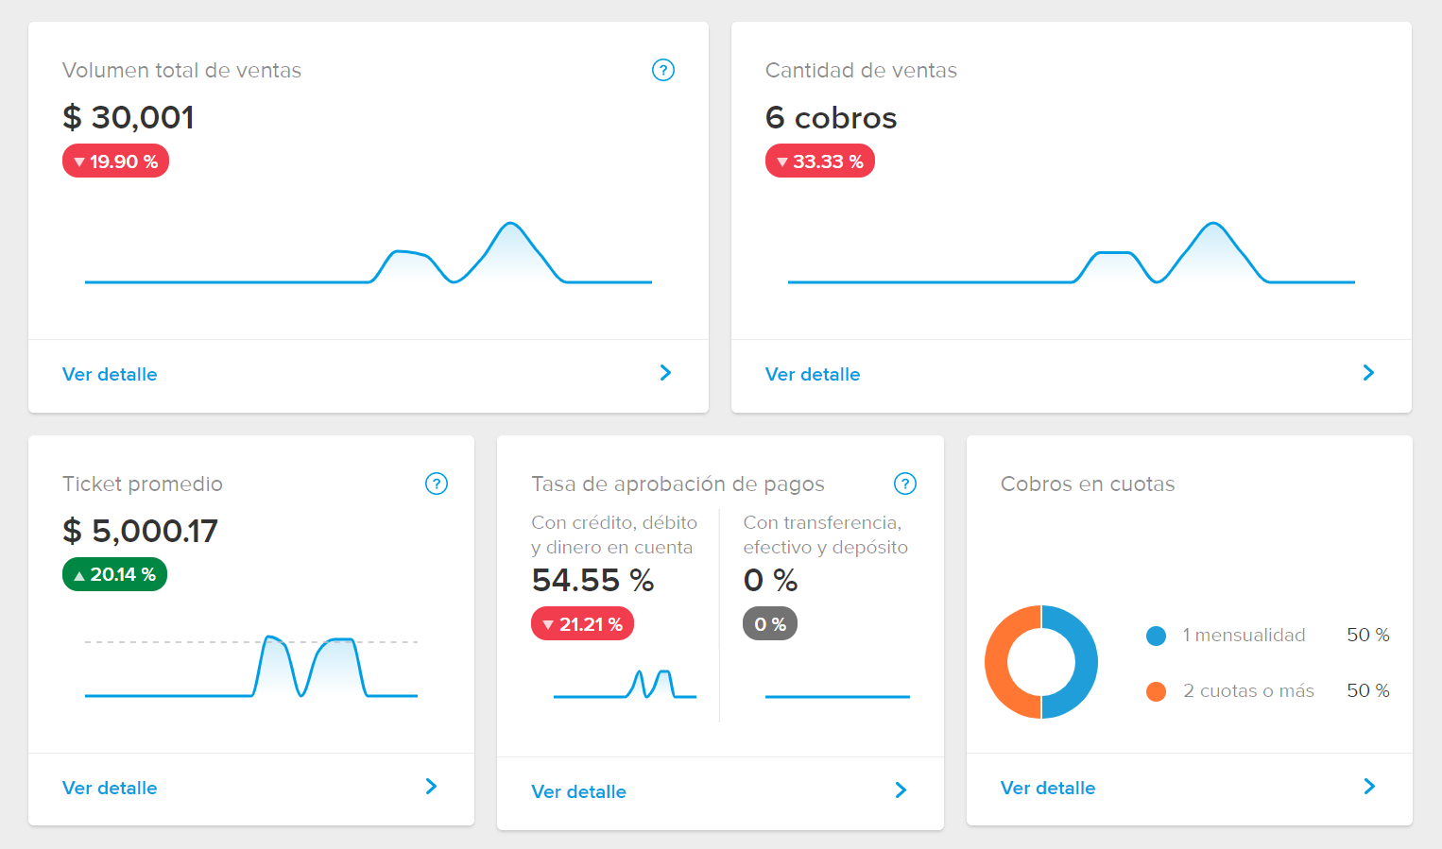
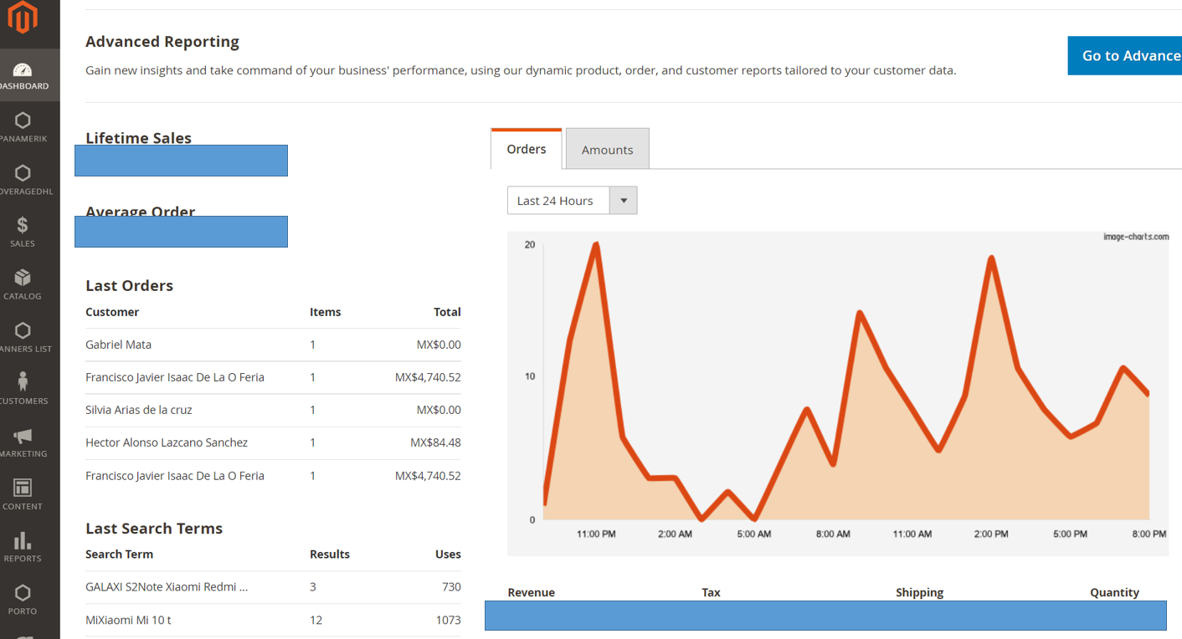

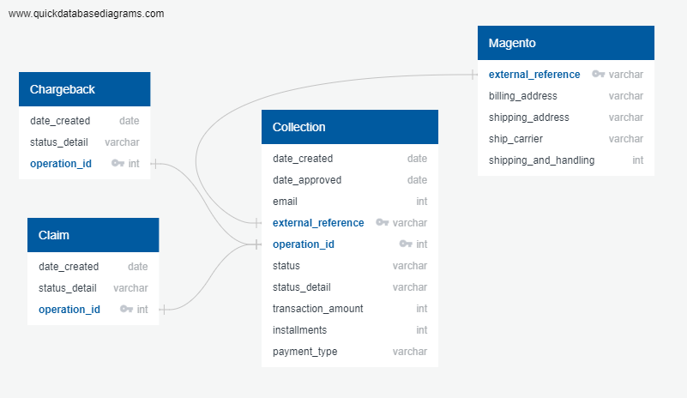
DESCRIPTION OF DATA SOURCE
DESCRIPTION OF DATA SOURCE (1/2)
MERCADO PAGO TRANSACTIONS

Slide 7
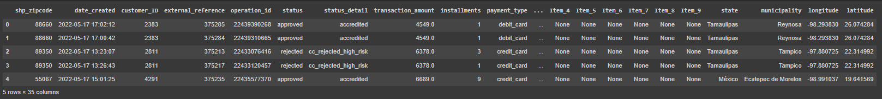
DATA EXPLORATION
DATA EXPLORATION
To complete the ETL of the sources we complete the next steps:
Decide the relevant columns to use of each file.
We use Pandas to complete a regex extract of information such as: postal code, items SKUs, etc.
We also use Pandas to complete the merge of sources and get the database use in the machine learning model.
Upload the first database to AWS and use Spark to join it with a Postal Codes database.
Use PGadmin to manage the final database in AWS

Slide 8
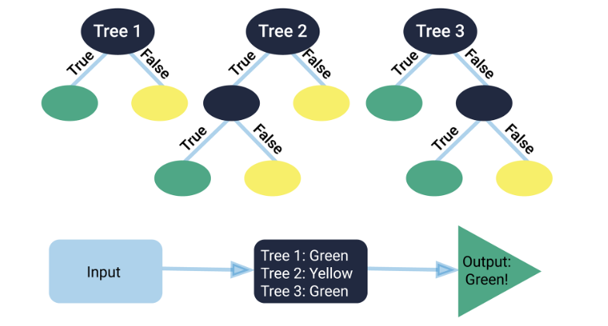
DATA ANALYSIS
DATA ANALYSIS
The first models used for the project were:
Oversampling : 50%
Decision tree : 98.3%
The final Model was Random Forest 98.6% Recall 30%
Can be used to rank the importance of input variables in a natural way.
Are robust to outliers and nonlinear data.
Run efficiently on large datasets.
Notes:
poner imagen resultados y resumir

Slide 9
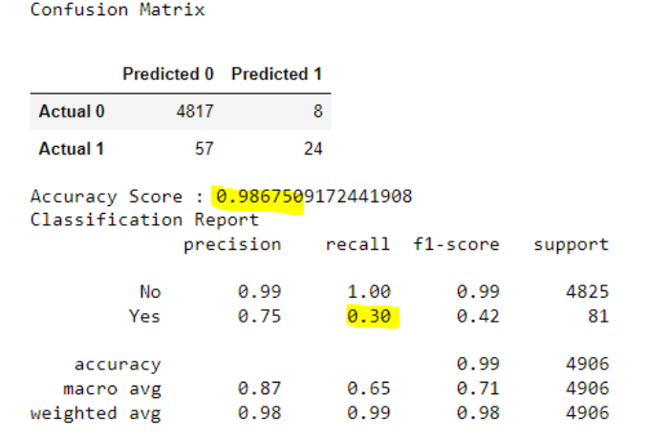
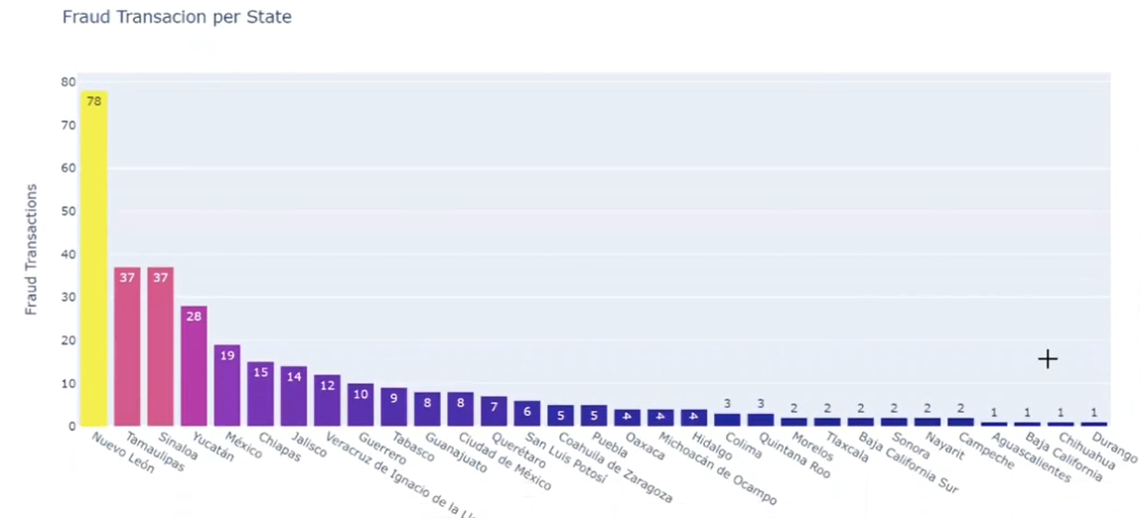
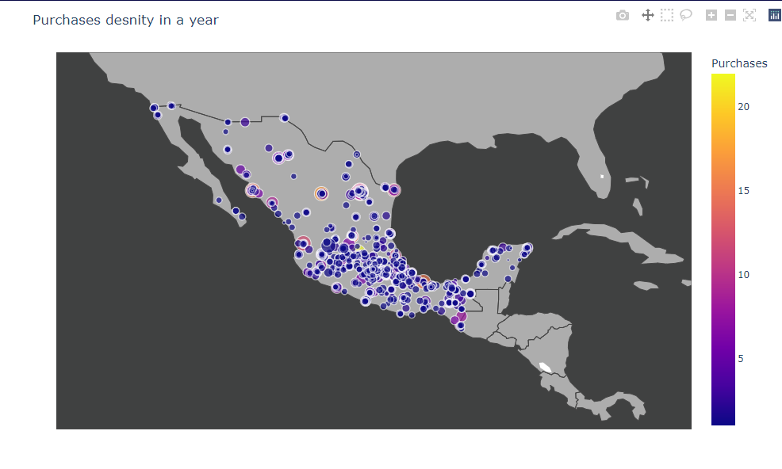
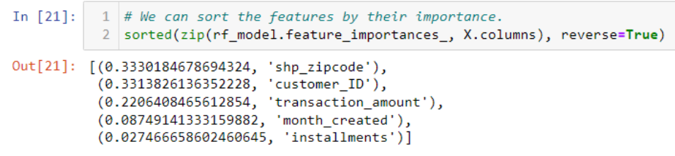
CONCLUSIONS
CONCLUSIONS
Notes:
poner imagen resultados y resumir

Slide 10
DASHBOARD
DASHBOARD
Click to dashboard!
Notes:
poner imagen resultados y resumir

Slide 11
QUESTIONS…?
QUESTIONS…?

